Slide 1
ESCCCP24 2025-2026 23 Feb 2026

Slide 2
Check-in
26 Feb 2026

Slide 3
Reading/Writing
17:45-20:45

Slide 4
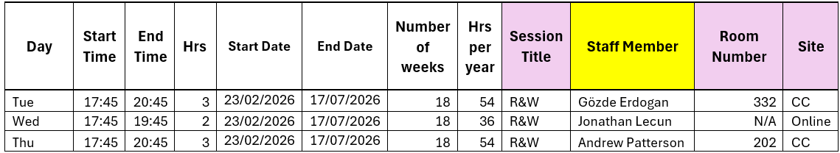
Timetable

Slide 5
Meet the class…

Slide 6
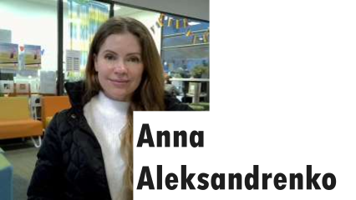
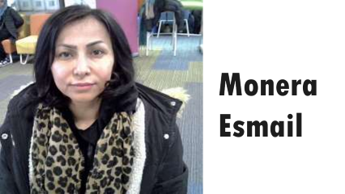
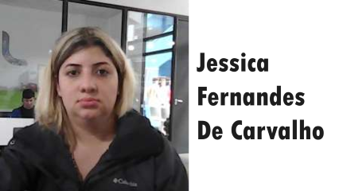
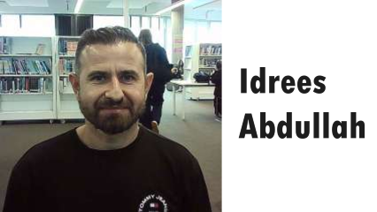
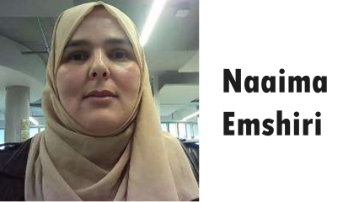
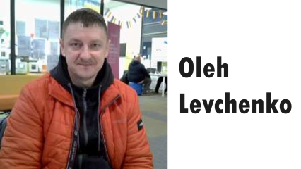

Slide 7
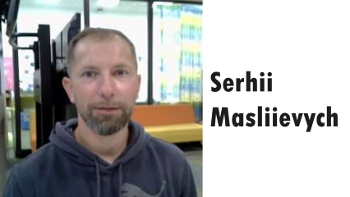
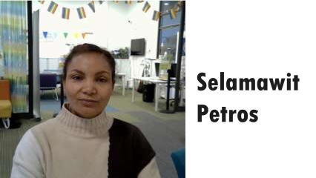
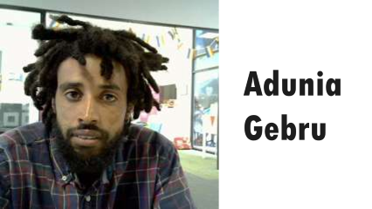
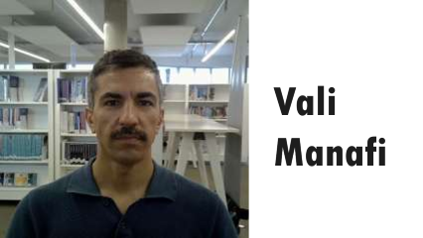
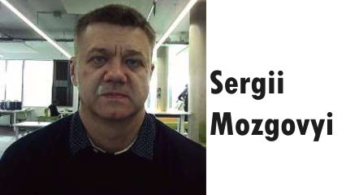
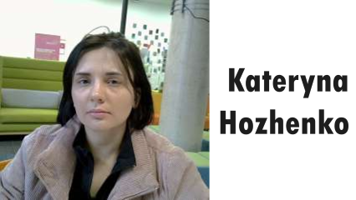

Slide 8
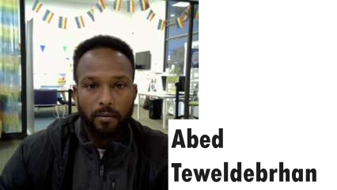
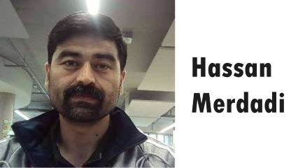
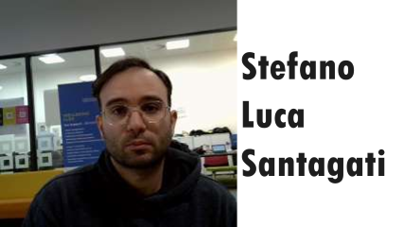
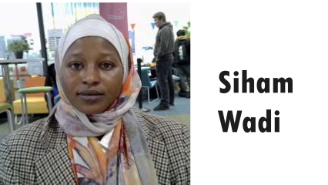
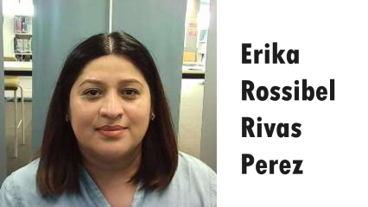

Slide 9
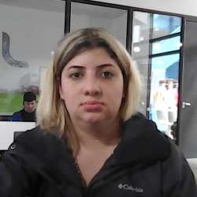
Jessica Fernandes De Carvalho

Slide 10
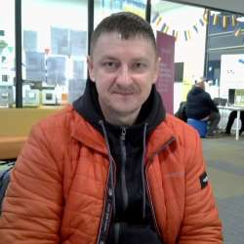
Oleh Levchenko

Slide 11
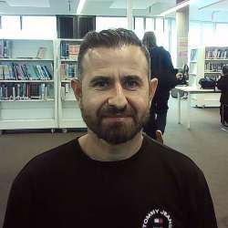
Idrees Abdullah

Slide 12
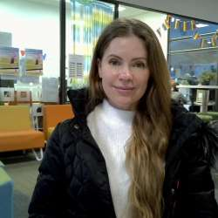
Anna Aleksandrenko

Slide 13
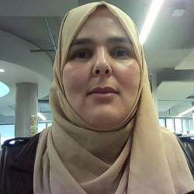
Naaima Emshiri

Slide 14
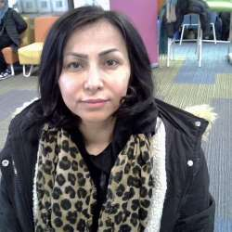
Monera Esmail

Slide 15
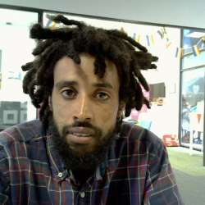
Adunia Gebru

Slide 16
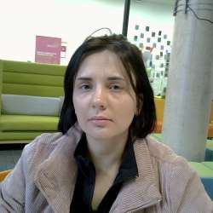
Kateryna Hozhenko

Slide 17
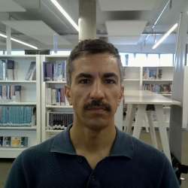
Vali Manafi

Slide 18
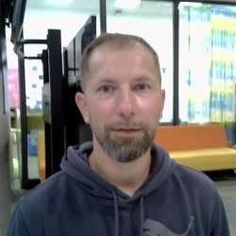
Serhii Masliievych

Slide 19
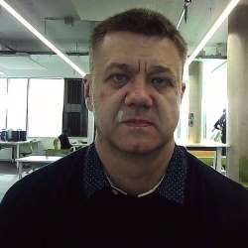
Sergii Mozgovyi

Slide 20
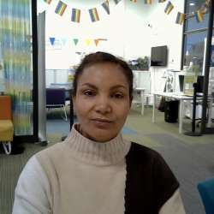
Selamawit Petros

Slide 21
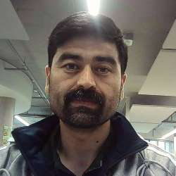
Hassan Merdadi

Slide 22
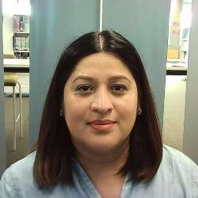
Erika Rossibel Rivas Perez

Slide 23
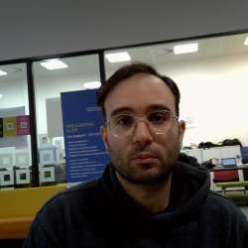
Stefano Luca Santagati

Slide 24
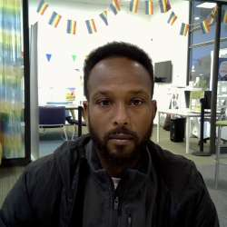
Abed Teweldebrhan

Slide 25
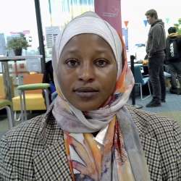
Siham Wadi

Slide 26
… and the teachers

Slide 27
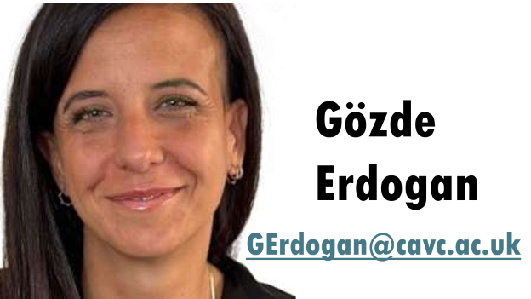
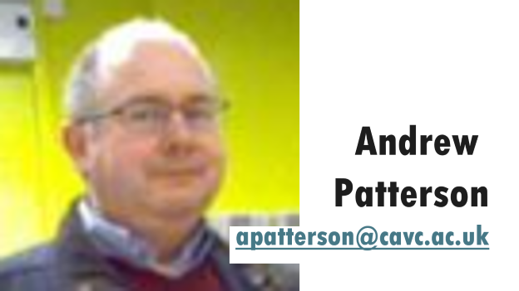
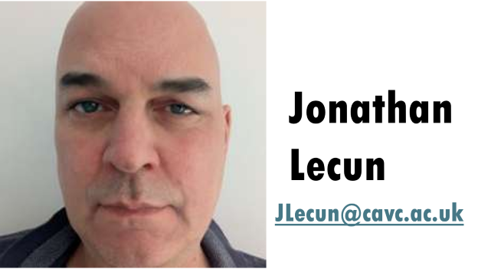

Slide 28
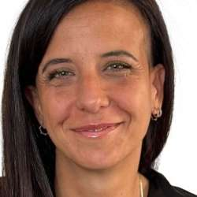
Gözde Erdogan
GErdogan@cavc.ac.uk

Slide 29
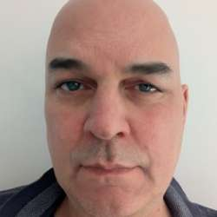
Jonathan Lecun
JLecun@cavc.ac.uk

Slide 30

Andrew
Patterson
apatterson@cavc.ac.uk

Slide 31
0) Writing Booklet
Writing Booklet Task 1 p. 6-17.pptx

Slide 32
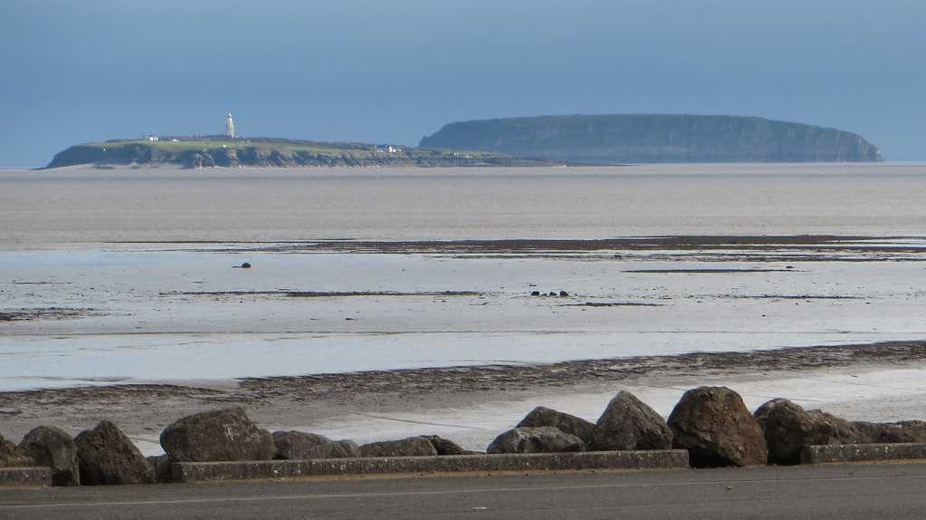
Flatholm
Steepholm

Slide 33
Check-out
26 Feb 2026

Slide 34
Work from 26 Feb 2026
Reading and Writing booklets were issued to those present.
Using Writing Booklet Task 1 p. 6-17.pptx made from
0) Writing Booklet, p. 6-9, we
learnt how to fill in a form Ascentis writing Task 1.
Homework
Form Practice 2 Task3 from the thin handout.
0) Writing Booklet p. 10-12. Bring next Thursday.
Form Practice 2
Task 3: Complete the form below
• You are applying for a volunteer role with a charity that looks after wildlife in West Wales.
• In this position, you would live for four months on Skokholm Island helping the wardens manage the island and monitor the wild animals.

